Slide 1
Information Radiator Explained with Examples
Presented By
335-Swaroop Kumar Reddy

Slide 2
What is Information Radiator?
An information radiator, also known as a Big Visible Chart (BVC), is a large graphical representation of project information kept plainly in sight within an agile development team’s shared workspace.
The term is generic rather than specific: information radiators can include most types of charts used in agile development. Burn down charts, task boards, planning boards and storyboards are among the possibilities.
An information radiator is usually hand-drawn or printed but can also include computer-generated charts and electronic displays.

Slide 3
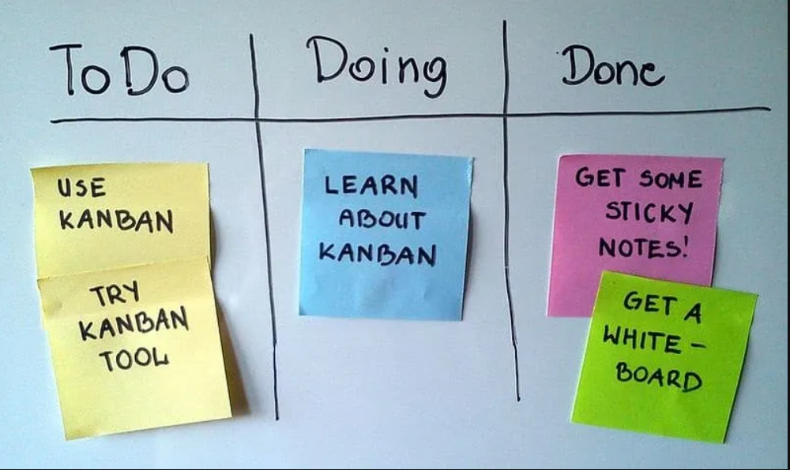

Slide 4
Why use an Agile information radiator?
An information radiator can be a good motivational tool for Agile teams. They will likely be using digital technology to store their information, but a large chart will offer a bird’s-eye view of progress.
Rather than making a conscious effort to check their progress online, a team member can simply glance at an information radiator to be reminded of how far they’ve come in a project.

Slide 5
Information radiators add a level of transparency. The team’s workload is clearly displayed for everyone to see, which enables accountability.
A BVC can also stimulate feedback, opening new communication channels between an Agile team and external stakeholders.

Slide 6
Information Radiation Examples
Some of the common information radiators used in Scrum include scrum boards owned by the development team, impediment list by the scrum master and spring burndown charts owned by the development team.

